Slide 1

Resident Text
Programming 4 2017

Slide 2
Resident Text
Game
A survival horror game
Limited amount of ammo and usable items and health
Story/event based game
Story: An unnamed hero that unravels the story of a horror house,
while searching for a lost friend.
Programming 4 2017

Slide 3
Resident Text
Gameplay
Moving and interaction with the world
Event system: predefined events that progresses the story
Creatures that roam the house
RPG battle element
Inventory based weight system for the player
Programming 4 2017

Slide 4
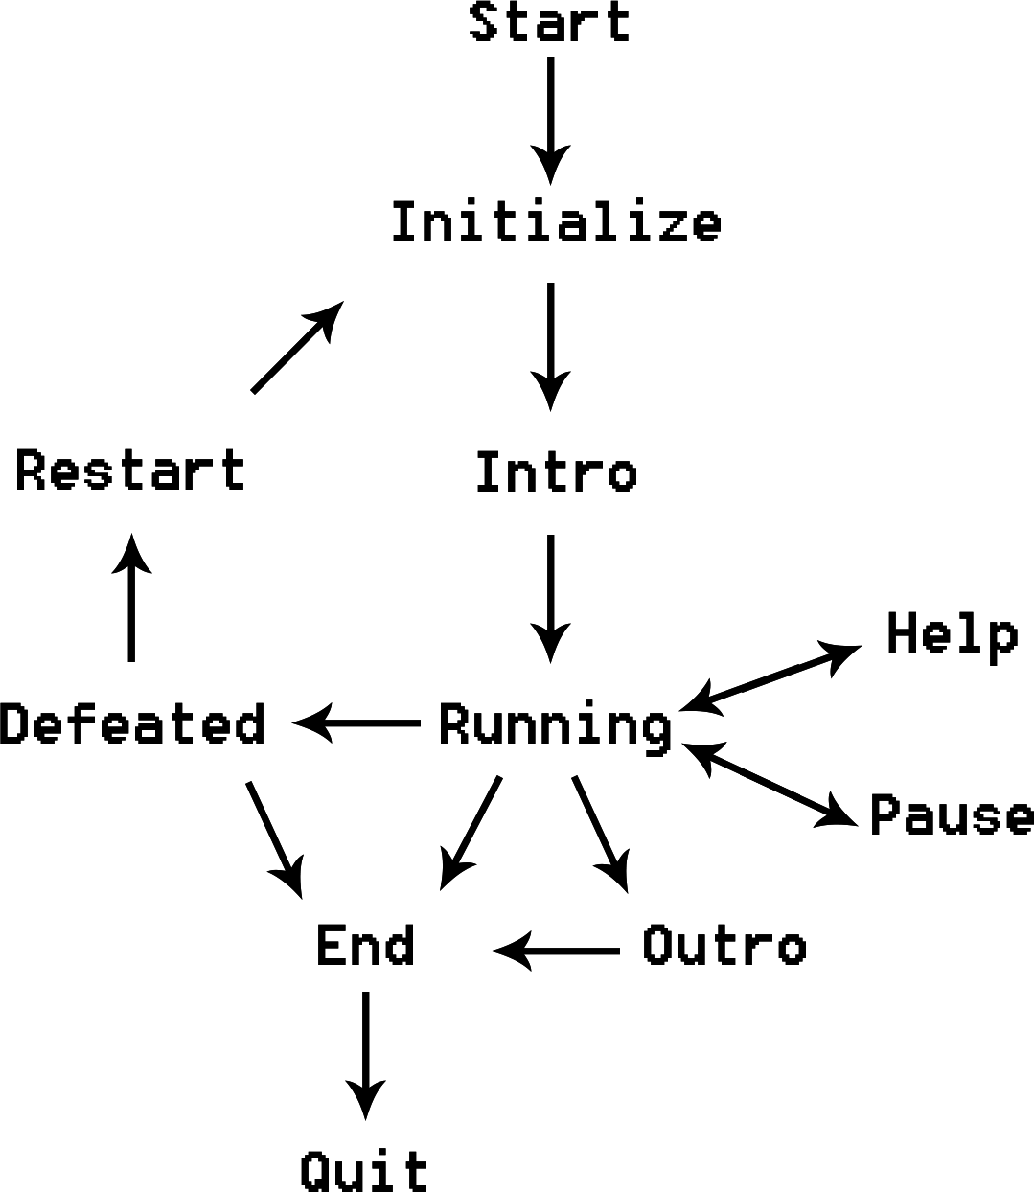
Resident Text
Game Technical 1: game loop
Initialize :
create Items
create WorldObjects
create World -> Nodes and Connections
add Events to world
create cin thread
Running:
Check if event is triggered
Check if encounter with creature
Programming 4 2017

Slide 5
Resident Text
Singleton
Game
Connection
Event
Item
Node
GameObject
Connection
Game Technical 2: game Architecture
Resident Text
GameObject
Creature
Player
Item
Inventory
Connection
Node
WordObject
Programming 4 2017

